Slide 1

RESEARCH PROPOSAL

Slide 2
PROJECT DETAILS
COURSE CODE
TEAM NUMBER
TEAM MEMBERS
DAB300
01
06
INSTRUCTOR
VICKY TAO

Slide 3

OUR TEAM
RAVINDERJIT KAUR
PRABHJOT SINGH
ANAS PATEL
JAYDIP
BARVALIYA
SHIVANI
SHARMA
HIRAL
VORA

Slide 4
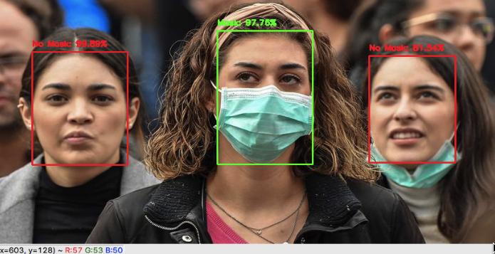
Face Mask Detection
Real-Time Implementation of AI-Based Face Mask Detection System for COVID-19 Prevention

Slide 5

SUMMARY
In the face of the COVID-19 pandemic, the World Health Organization (WHO) declared the use of a face mask as a mandatory biosafety measure.
Additionally, there are no efficient face mask detection applications that are now in high demand for transportation means, densely populated areas, residential districts, large-scale manufacturers, and other enterprises to ensure safety.
This has caused problems in current facial recognition systems, motivating the development of this research. Therefore, this has to lead us to the development of a system for recognizing people, even when they are using a face mask, from photographs.

Slide 6
PROJECT DETAILS
INTRODUCTORY BACKGROUND
AIMS/ OBJECTIVS
RESEARCH QUESTIONS
FRAMEWORK/ METHODS

Slide 7

INTRODUCTORY BACKGROUND
University of Edinburgh reveals that wearing a face mask or other covering over the nose and mouth cuts the risk of Coronavirus spread by avoiding forward distance travelled by a person’s exhaled breath by more than 90%.
The findings reveal that near universal adoption (80%) of even weak masks (20% effective) could prevent 17–45% of projected deaths over two months in New Work and reduces the peak daily death rate by 34–58%
All in all, results strongly recommend the use of the face masks in general public to curtail the spread of Coronavirus using any AI based system where there is no any involvement of human even for the system.

Slide 8

RESEARCH QUESTIONS
SMALL DATASET: It is NOT easy to detect faces with/without a mask in public as the dataset available for detecting masks on human faces is relatively small leading to the hard training of the model. So how can we extend the dataset at runtime?
RESULT IS NOT BASED ON LATEST TRAINING: Although there exist several open-source models that are pre-trained on benchmark datasets, but a few models are currently capable of handling "latest trained output". how can we maximize the model training with latest dataset?
LIMITED BY COMPUTE POWER AND MEMORY Existing devices are limited by less computational power and memory because of they are mostly INTEGRATED to hardware such as raspberry pi or Arduino. How can we replace this with some latest tech-stack?

Slide 9

AIMS/OBJECTIVS
After initial training of model we can start storing every input images(which is person's face image) into our untrained dataset. So the very next model training can use the untrained dataset as their input help system to increase accuracy.
Traditional system has very less model training frequency as training is extensive process of the system. To resolve this, system can train model when the system usage frequency is very less( to refrain from downtime or with less fault tolerance)
If we integrate system by harnessing the power cloud computing then we can refrain from the problems like limited compute and memory and we can also increase the efficiency of model training as cloud can provide higher CPU power while training and also we can make use of horizontal scaling of system rather then vertical

Slide 10

FM:1 – Base
Scripting Language : Python with power lib
Framework : Machine Learning(statistical data) and Deep Learning(to combine various layers like masked face and without it)
Face Mask Detection : Another task in research is detecting people with or without mask, that can be done using deep learning-based model named OpenCV (Open Source Computer Vision) is a library of programming functions mainly aimed at real-time computer vision. In simple language it is library used for Image Processing such as Read and Write Images/Detection of faces and its features and many more.

Slide 11

FM:2 - Backbone Library of System
TensorFlow : It is a foundation library that can be used to create Deep Learning models directly or by using wrapper libraries that simplify the process built on top of TensorFlow. in this project we will use to train machine learning model. (Tensorflow is a way to implement most of the things that we used in deep learning and machine learning into code)
Numpy : adding support for large, multi-dimensional arrays and matrices, along with a large collection of high-level mathematical functions to operate on these arrays. In this project it will forms the foundation of the Machine Learning stack
Other Libraries: scipy(visualization) and pillow(for image)

Slide 12

FM:3 - Techniques With Cloud
Affine Transformation technique : Improved affine transformation is developed to crop the facial areas from uncontrolled real-time images having differences in face size, orientation and background. This step helps in better localizing the person who is violating the facemask norms in public areas/ offices.
AWS: In order to test and deploy the system in minimal time with higher computer power and mainly for high availability after the deployment of the system

Slide 13

PLAN & TIMELINE
RESEARCH
DEVELOPMENT
TESTING
DEPLOYMENT
2001
2002
2003
2004

Slide 14

RESEARCH
Explore various machine learning libraries of python and thoroughly testing
Deep dive into model training in ML as it is heart of system procedure
Research on suitable cloud technology which is compatible with project outline
Explore different cloud storage as project will consists of tons of datasets
Research on existing similar system and It’s functions
Research of various AWS service API as it will receive and sent in various form between cloud services

Slide 15

DEVELOPMENT
GitHub repository creation and assignment of access and various module to each and every project contributor
Development of system and it’s various features
Development of AWS environment
Scaffold of initial dataset and low level model training
Storing and retrieving images from the cloud services using AWS SDK

Slide 16

TESTING
Accuracy testing of system
Load testing of system
System test on local environment
Bug fixes and various exceptional image/edge case testing
System testing while model training procedure

Slide 17

DEPLOYMENT
Deployment of various component on suitable AWS services
Investigation of accuracy after deployment and changes if require
Deployment of various component on suitable AWS services
CPU usage and Memory usage of cloud resources while deployement
Horizontal Scaling of system

Slide 18

THANK YOU

